Slide 1
Over-the-air update strategies via 5G
Binary Buds
Ruben
Sachim
Nils
Notes:
Introduce our Topic and the Team Members

Slide 2
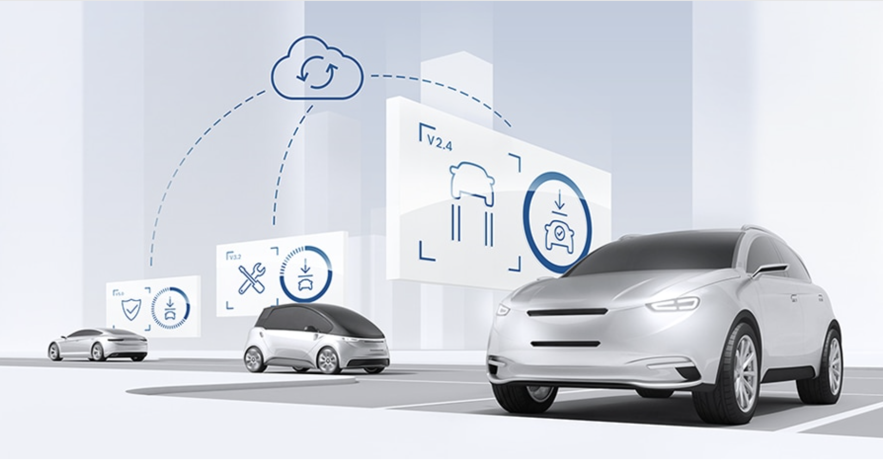
Notes:
Over the air updates are important in the industry, for example what happens if you have a mandatory security update and you want to update your fleet as fast as possible

Slide 3
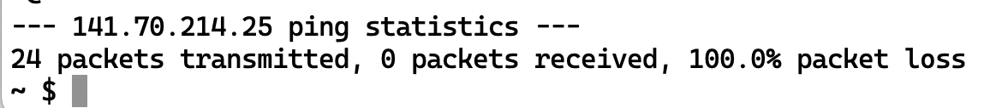
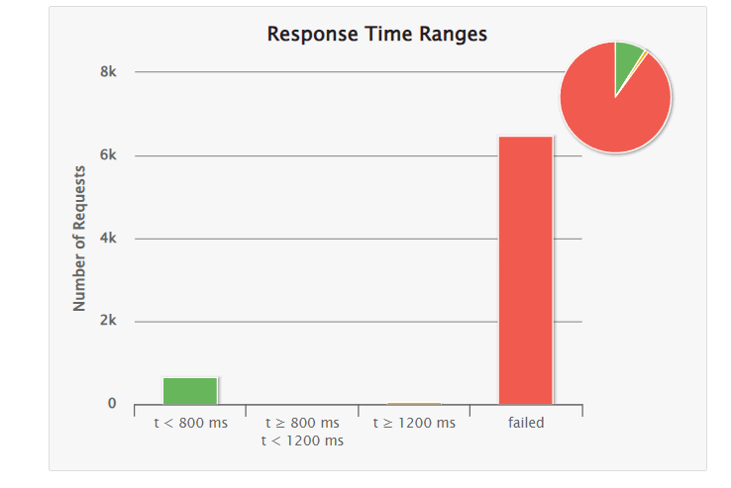
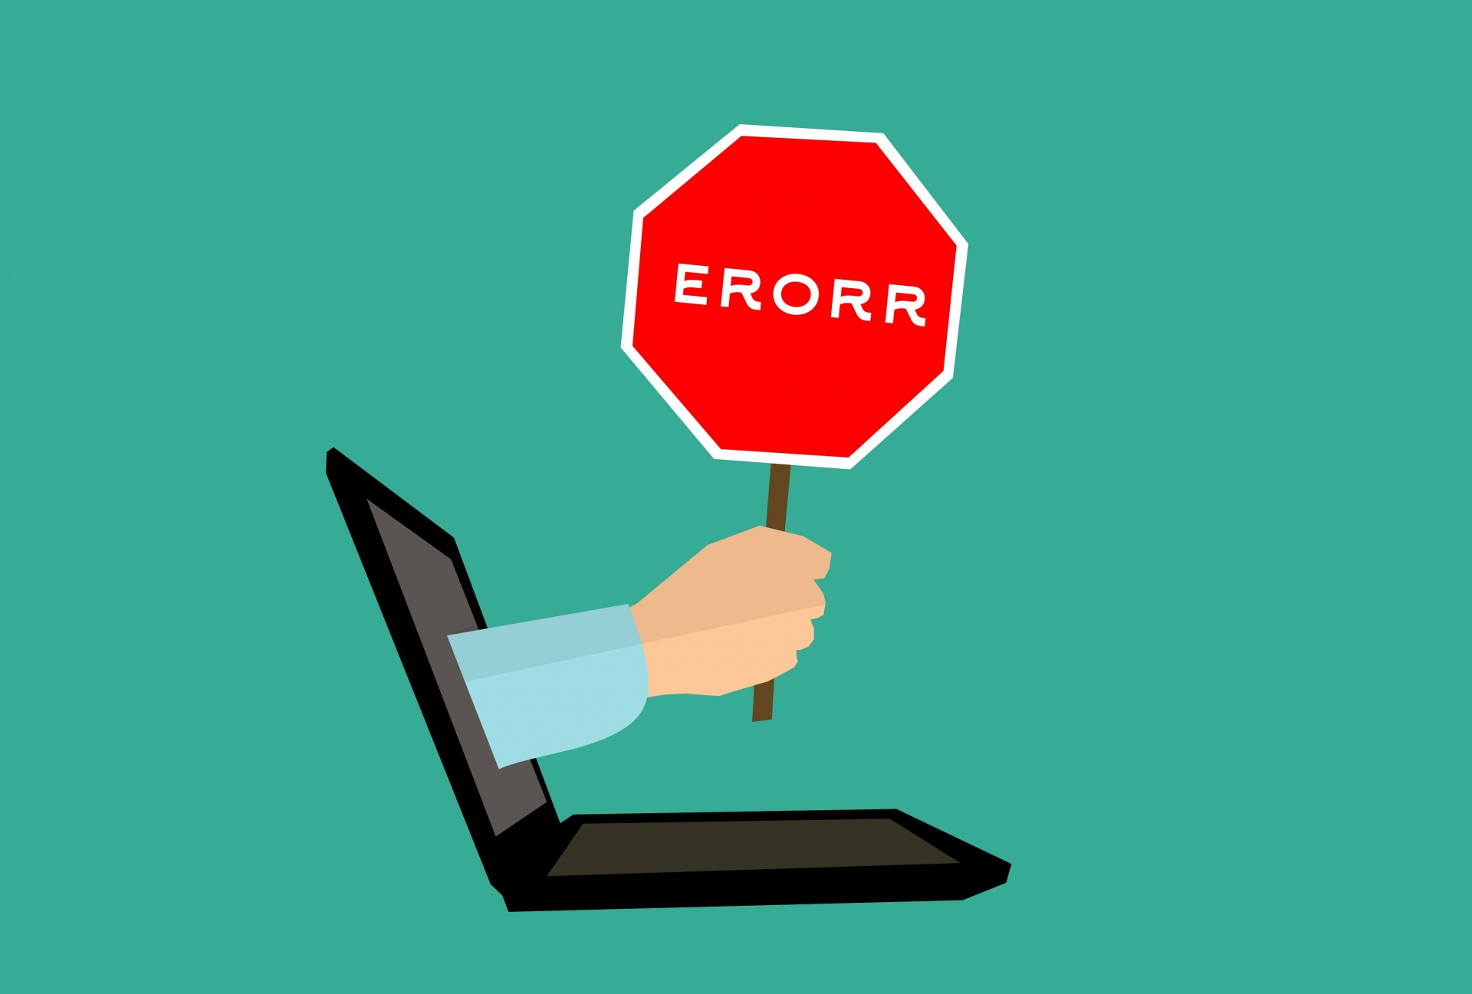
Enganging Introduction!
Notes:
How did we start?
1st we tried to connect the clients in the 5G
What happened? Well we got Errors
(click)
While fixing our errors we were setting up our clients and our server in ordert to start the simulation. Here we run in the next errors,
(Click) - failed packages.
But was is our topic about?

Slide 4


Initital State
Client
Client
OTA Server
Notes:
This work is based on a bachelor thesis of a student.
He deployed some clients and server in the cloud via docker container and made some research about different OTA techniques. He tried to find out about their characteristics, to identify which properties were especially important for updating a car fleet and their QoS aspects.

Slide 5


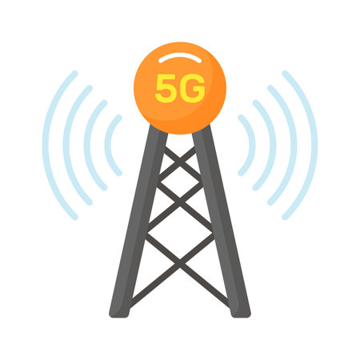
Our Approach
Client
Client
OTA Server
Client
Notes:
In Our Approach we wanted to test out the 5G devices and see what the actual limits of the 5G Network are
What are potential Capacities we can send or with which data chunks sizes should we use to receive the best results

Slide 6
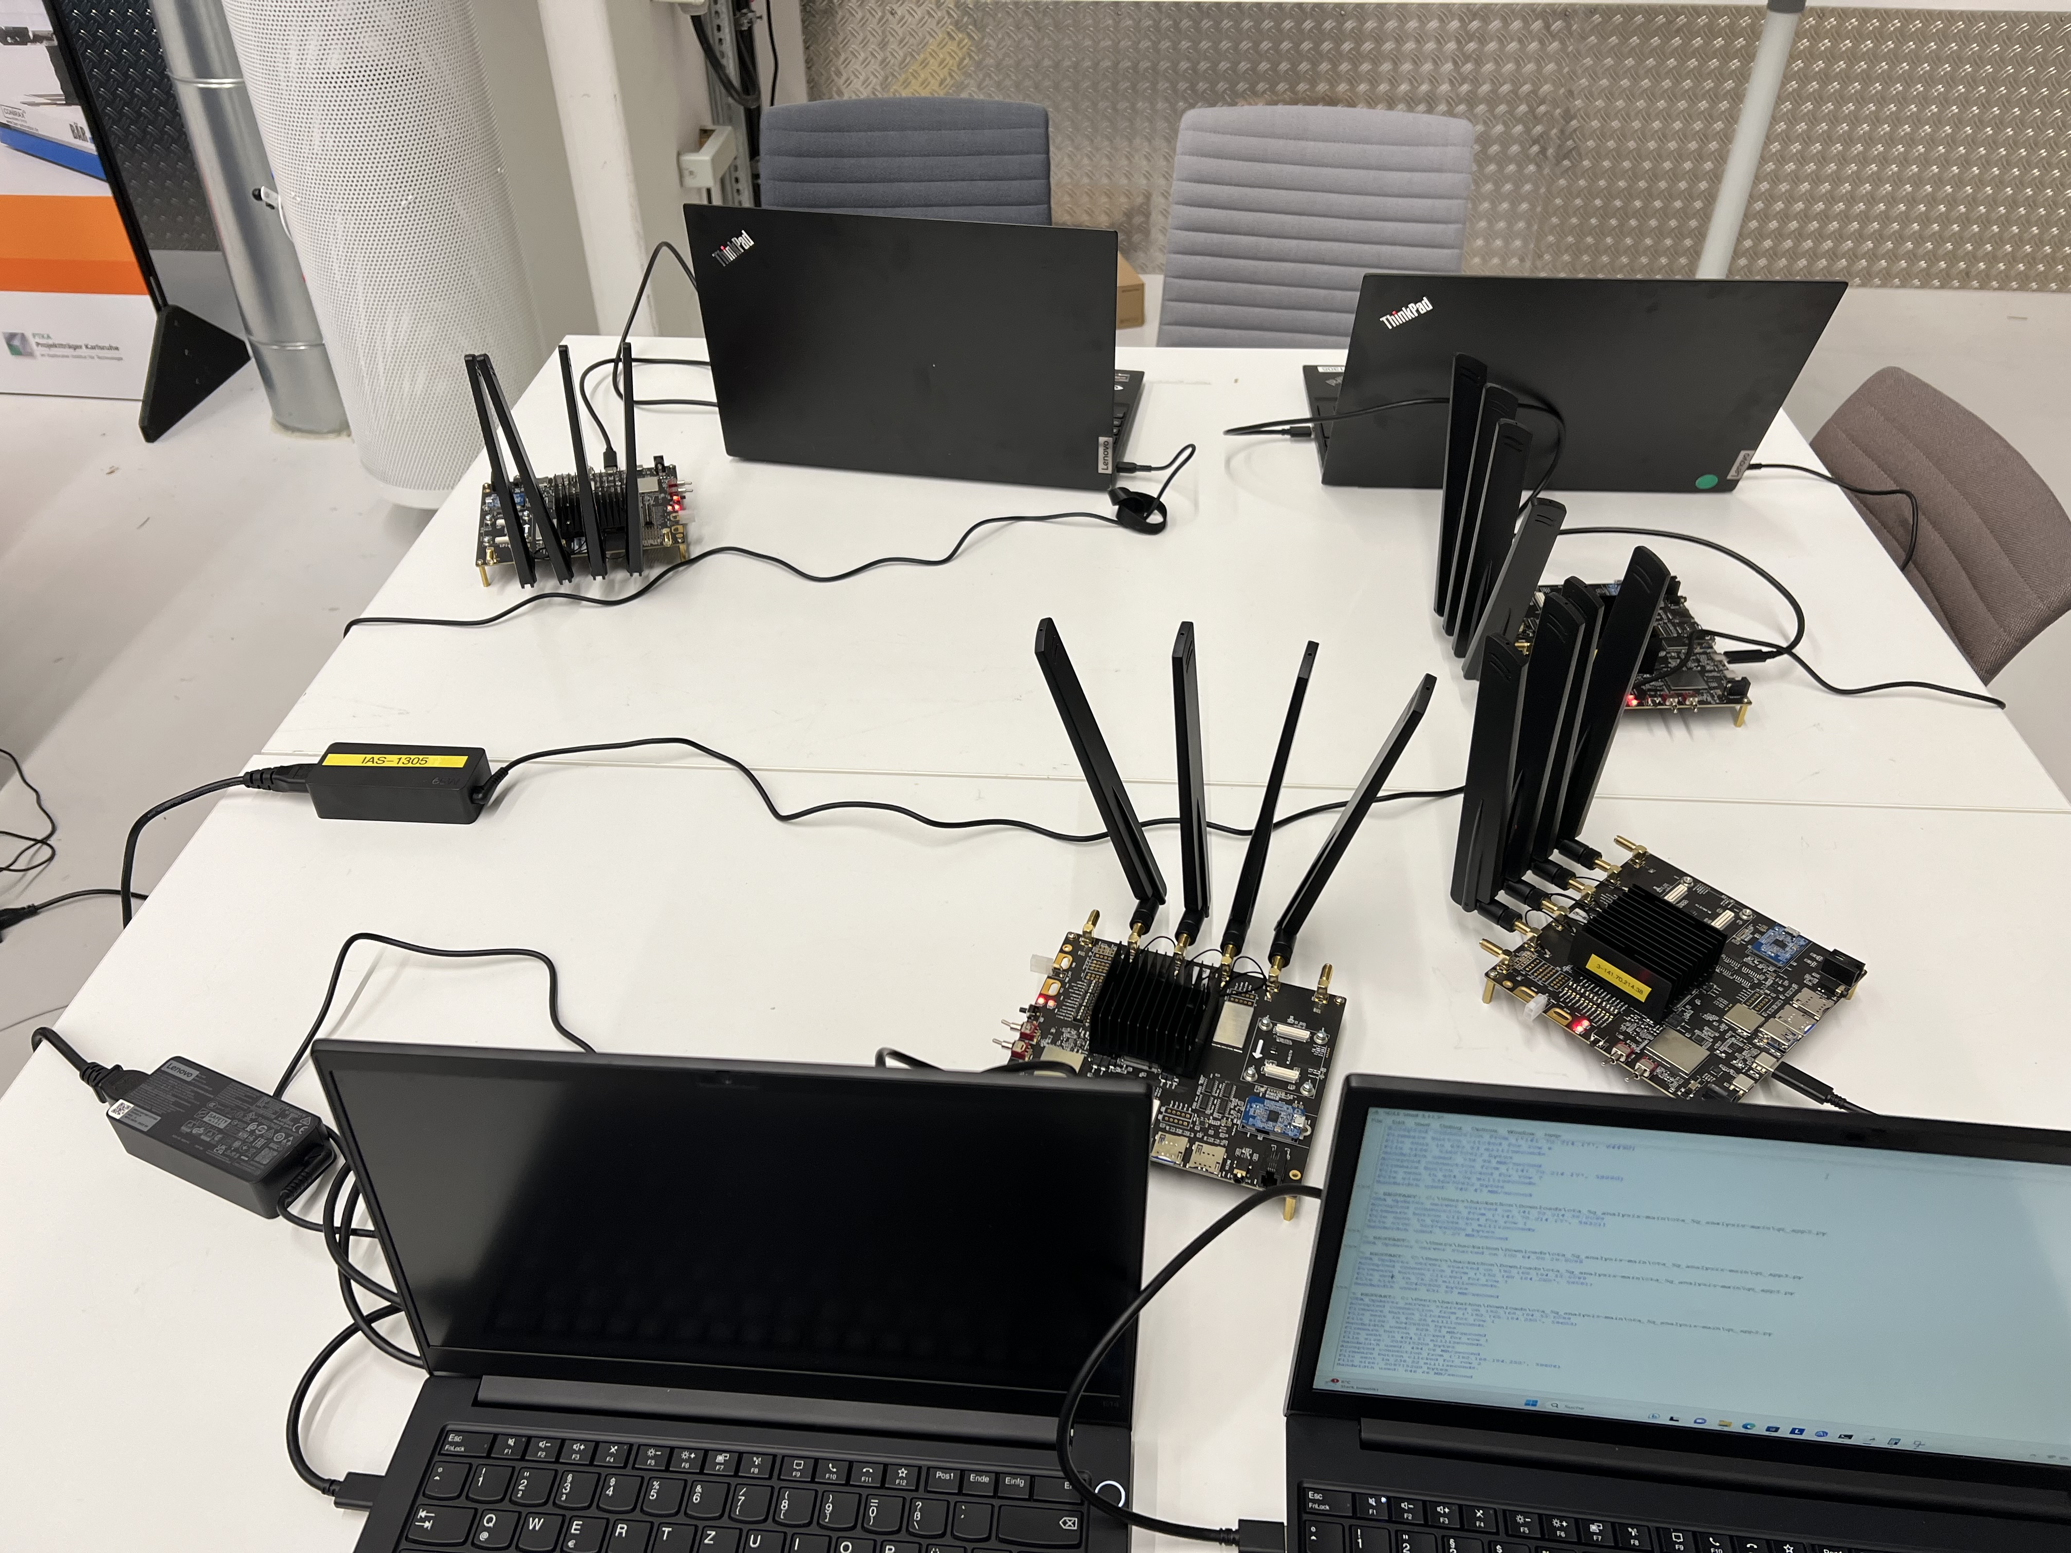
Real life Scenario

Slide 7
Expectations
Bottlenecks: client and hardware – not the actual bandwidth of 5G (10 Gbit/s)
Improve the speed of the connection via 5G

Slide 8
Results

Slide 9
Results
Comparison
Notes:
Reference Architecture

Slide 10
Conclusion
Network did not utilize max. Bandwidth
From 10 G bit/s we achieved
Notes:
Even if we beat the reference implementation, the network capabilities were far from unused

Slide 11
Conclusion
Approximately 64 M bit/s

Slide 12
Questions
What are the actual bottlenecks?
Network?
Hardware?
How much load is in the network?
Notes:
Wireshark?

Slide 13
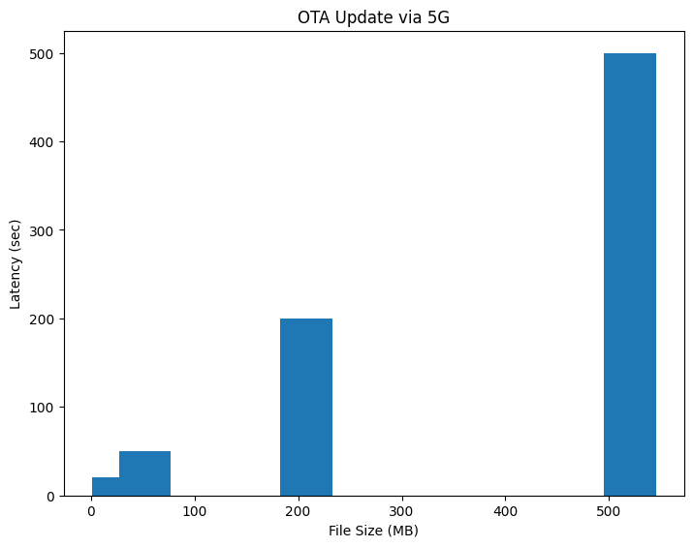
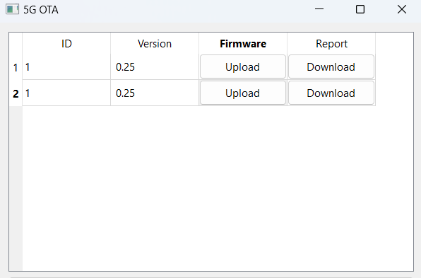
OTA Measurement Tool

Slide 15
Future Work
More Clients
Investigating the modules
Real Updates
Create an intuitive UI

